Slide 1


Green Pace
Security Policy Presentation
Developer: Karen Bevis

Slide 2

OVERVIEW: DEFENSE IN DEPTH

Slide 3
THREATS MATRIX
Likely These are threats that are very likely to happen. | Priority These are threats/standards with high relevance
Low priority These are threats/standards with low relevance | Unlikely These are threats that not likely to happen
This chart priorities the vulnerabilities that measure the levels of

Slide 4
10 PRINCIPLES
1. Validate Input Data
2. Heed Compiler Warnings
3. Architect and Design for Security Policies
4. Keep it Simple
5. Default Deny
6. Adhere to the Principle of Least Privilege
7. Sanitize Data Sent to Other Systems
8. Practice Defense in Depth
9. Use Effective Quality Assurance Techniques
10. Adopt a Secure Coding Standard

Slide 5
CODING STANDARDS
There are many coding standards. Other than the top 10 basic principles, here at Green Pace, we comply with important coding standards as well. Here are our top ten coding vulnerabilities standards that we comply with:
1. Do not declare or define a reserved identifier
2. Do not cast to an out of range enumeration value
3. Guarantee that storage for strings has sufficient space for character data and the null terminator
4. Do not use deprecated or obsolescent functions
5. Free dynamically allocated memory when no longer needed
6. Use a static assertion to test the value of a constant expression
7. Do not leak resources when handling exceptions
8. CPP. Close files when they are no longer needed
9. Use valid iterator ranges
10. Ensure that operations on signed integers do not result in overflow

Slide 6
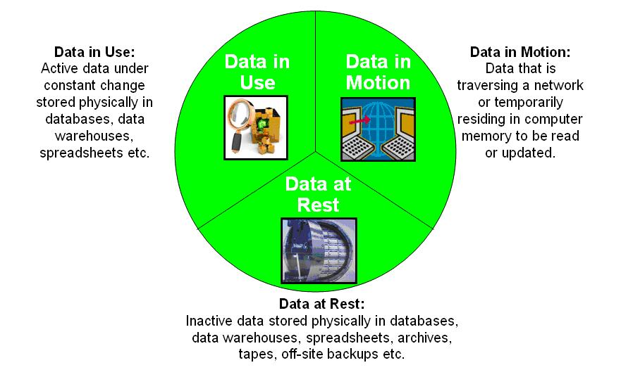
ENCRYPTION POLICIES

Slide 7
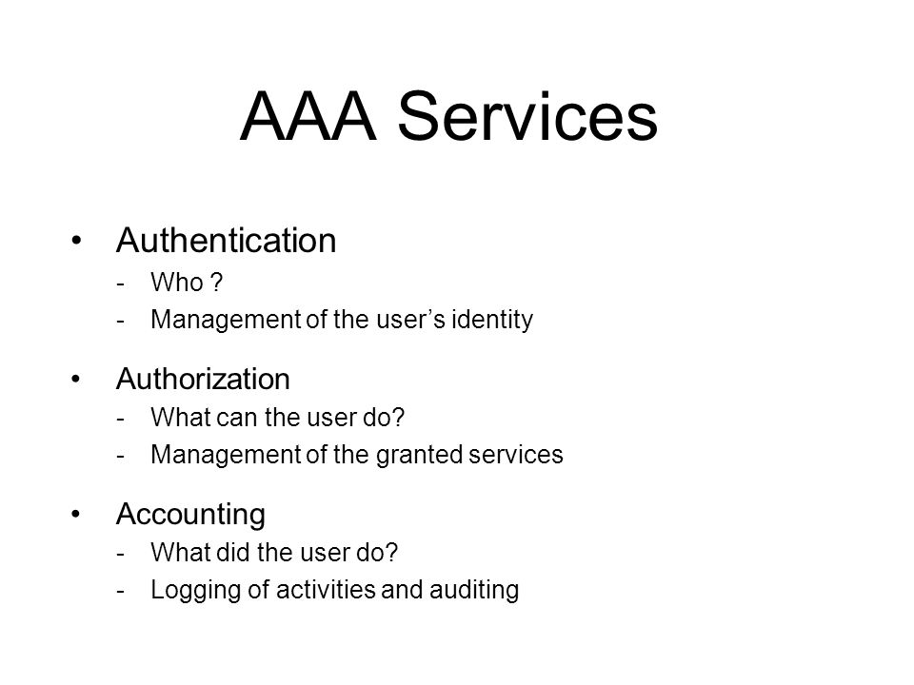
TRIPLE-A POLICIES

Slide 8
Unit Testing
I am not done with this assignment and haven’t gotten it turned in yet.

Slide 9

AUTOMATION SUMMARY

Slide 10
TOOLS
Threat Modeling
Security Tool Training
Static Application Testing
Automated Security Scans
Network Monitoring
Penetration Testing
Performance logs

Slide 11

RISKS AND BENEFITS
Improper access controls
Weak credential managemt
Cryptgraphic and privilege issues
Security misconfiguration

Slide 12

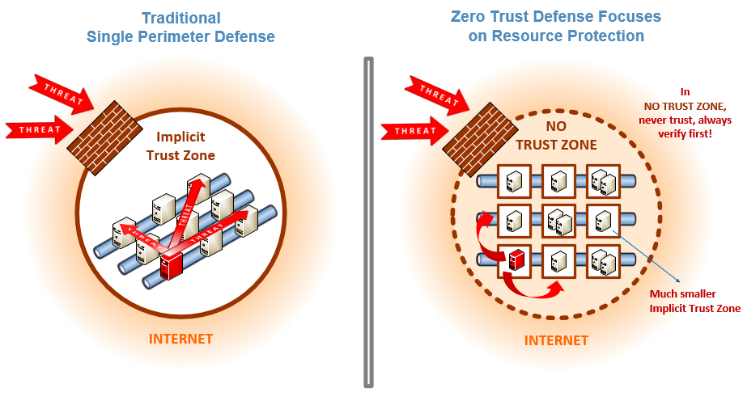
RECOMMENDATIONS

Slide 13
CONCLUSIONS
In conclusion, thank you for listening and watching this presentation. The principles and standards will maintain, secure and take Green Pace to new standards in protecting the data that it collects, stores and maintains from it clients and employees. The plan that you have seen will create policies to maintain and secure proficient programming for Green Pace. The Zero-Trust policy will make sure to keep all access to information only to those who have access on a least privilege access. Again, my contact information is available to anyone who needs it. Thank you for your time!

Slide 14
REFERENCES
Seacord, R. (2020, November 18). Confluence. Retrieved from SEI
External Wiki Home: https://wiki.sei.cmu.edu/confluence/

